Slide 1
Customised Investment Portfolios
West Indies Stockbrokers Limited
Date: October 14th 2021

Slide 2
Agenda
Introduction of Panel
The Customised Investment Portfolios | 3
Example of Index and ETF | 4-5
Benefits of Investing in CIP | 6
Responsible Parties | 7
Factors considered in ETF selection | 8
The Portfolios | 9-14
Outlook & Risk | 15-19
Portfolio Performance | 20
Suitability | 21
Next Steps to Start Investing | 22
Other offerings by WISE | 23
Questions | 24

Slide 3
The Customised Investment Portfolios (CIPs)
Three investment portfolios comprised primarily of Exchange Traded Funds (ETFs)
Grants access to the global stock and bond markets
Exchange Traded Funds (ETFs):
Diversified portfolios of securities that track specific market indices, sectors or commodities
Invest in any asset class
Marketable
Prices fluctuates as the ETF is bought and sold on the market
Lower expense ratios than buying stocks individually
Include U.S. holdings and international securities
Market Index:
Hypothetical portfolio of investments that represents a segment of the financial market
Index value derived from the prices of the underlying holdings
Used to gauge market segment performance
Popular Market Indices:
S&P 500 Index (GSPC)
Dow Jones Industrial Average (DJIA)
Nasdaq Composite Index (NDAQ)
Bloomberg Barclays U.S. Aggregate Bond Index

Slide 4
Example – S&P 500 Market Index
Comprised of the 500 largest publicly traded companies in the U.S.
Widely regarded as the best gauge of large-cap U.S. equities.
Top ten holdings as follows:
Company | Ticker | % of Index
Apple | AAPL | 6.2%
Microsoft | MSFT | 5.9%
Amazon | AMZN | 3.9%
Facebook | FB | 2.4%
Alphabet Class A (Google) | GOOGL | 2.3%
Alphabet Class C (Google) | GOOG | 2.2%
Telsa | TSLA | 1.5%
Nvidia | NVDA | 1.5%
Berkshire Hathaway | BRK.B | 1.4%
JP Morgan Chase | JPM | 1.3%

Slide 5
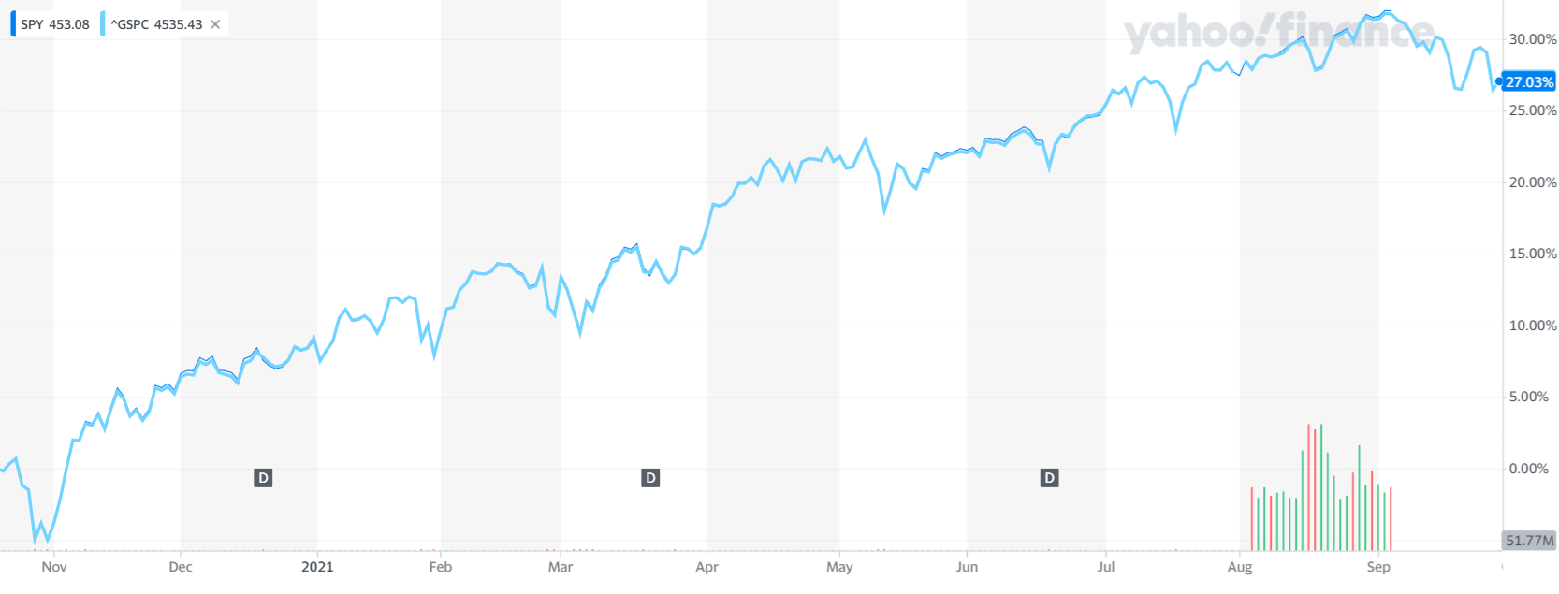
Example - Exchange Traded Funds vs Market Index
ETF SPDR S&P 500 (SPY) tracks the S&P 500 Index (GSPC).
The graph below compares performance of the SPY and GSPC
The SPY very closely tracks the GSPC.
SPY provides exposure to the 500 stocks within the GSPC.

Slide 6
Benefits of Investing in CIP
Diversification to a wide range of securities and industry sectors through various ETFs
Portfolio allocation decisions are made under the advice of RBC Investment Management (Caribbean) Limited, one of the leading asset managers in Trinidad & Tobago
The ability to switch among or withdraw from the portfolios as your investment objectives change
Transparency of cost and holdings
Easy and low cost access to global equity, fixed income and real estate markets
Automatic cash management and portfolio rebalancing

Slide 7
Responsible Parties
Custodian: Pershing
Investment Advisor: RBC Investment Management (Caribbean) Limited
Sponsor: WISE
Provides WISE with investment advice on security selection
Provides technology solution
Reviews and implements investment advice provided by the investment advisor
Markets the CIP
Accepts funds from client and executes trade
Provides clients the access to monitor the performance of the portfolios via NetX360
Provides client statements

Slide 8
Factors Considered in ETF selection
Size: Market Capitalization > US$ 1 Billion
Liquidity: Liquidity of the Fund itself as well as of the underlying securities
The Underlying Index: A good reflection of the desired exposure without excessive concentration
Tracking Error: Small difference between the returns of the ETF and its benchmark index
Small Bid / Ask Spread: Funds with higher average daily trading volumes and more assets under management tend to trade at tighter spreads
Adequate disclosure

Slide 9
Objective & Asset Allocation Balanced Income Portfolio
Invest in a portfolio of both bonds and equity with an emphasis on return earned through income generation via interest and dividends.
Bonds – Favour Non-Investment Grade over Investment Grade
Equities – Favour stable, large cap, income-producing businesses
Allocation Range for each asset class: 40 – 60%

Slide 10
Balanced Income Portfolio Top Ten Holdings as of Sept 2021
Asset | Asset Type | % of Portfolio | Top 10 Holdings as a % of Portfolio
Prologis | REIT | 1.9660% | 8.73%
Public Storage | REIT | 0.9720%
Digital Realty | REIT | 0.9120%
Simon Property Group | REIT | 0.8720%
AT&T Inc | DIVIDEND | 0.8460%
WellTower Inc | REIT | 0.7220%
Exxon Mobil Corp | DIVIDEND | 0.6330%
AvalonBay Communities | REIT | 0.6320%
Chevron Corp | DIVIDEND | 0.6030%
Equity Residential | REIT | 0.5700%

Slide 11
Objective & Asset Allocation Balanced-Growth Portfolio
Invest in a portfolio of both bonds and equity with an emphasis on return earned primarily through capital appreciation as well as via interest and dividend income
Bonds – Focus on investment grade
Equity – Focus on growth and increased concentration
Allocation Range:
Equities 50 – 70%;
Fixed Income 30 – 50%

Slide 12
Balanced Growth Portfolio Top Ten Holdings as of Sept 2021
Asset | Equity Selection | % of Portfolio | Top 10 Holdings as a % of Portfolio
Apple Inc | LARGE CAP | 2.3800% | 10.96%
Microsoft Corp | LARGE CAP | 2.2720%
Alphabet Inc (Google) | LARGE CAP | 1.6980%
Amazon.com | LARGE CAP | 1.4860%
Facebook Inc | LARGE CAP | 0.9080%
Tesla Inc | LARGE CAP | 0.5660%
Nvidia Corp | LARGE CAP | 0.5580%
UnitedHealth Group | LARGE CAP | 0.3920%
VISA Inc | LARGE CAP | 0.3880%
Idexx Laboratories | SMALL CAP | 0.31600%

Slide 13
Objective & Asset Allocation Growth Portfolio
Invest in a portfolio of equities with an emphasis on return earned primarily through capital appreciation
Higher exposure to specific high growth sectors
Higher concentration of exposure
Allocation Range: Equities 90 – 100%

Slide 14
Growth Portfolio Top Ten Holdings as of Sept 2021
Asset | Asset Type | % of Portfolio | Top 10 Holdings as a % of Portfolio
Apple Inc. | LARGE CAP/TECH | 5.28% | 18.94%
Microsoft Corp | LARGE CAP/TECH | 4.55%
Amazon.com | LARGE CAP/CON DISC | 2.97%
Tesla Inc | LARGE CAP/CON DISC | 1.24%
Nvidia Corp | LARGE CAP/TECH | 1.08%
Moderna Inc. | BIO TECH | 0.92%
Alphabet Inc. (Google) | LARGE CAP | 0.88%
Amgen | BIO TECH | 0.69%
Gilead | BIO TECH | 0.65%
Home Depot | CON DISC | 0.64%

Slide 15
General Outlook
Growth was almost universally better than anticipated in the first two quarters of 2021 across both advanced and developing economies.
The combination of vaccines and better management of the economic impact of the virus has led to stronger-than-expected performance so far this year.
Recovery has become more self-sustaining versus stimulus driven.
Existing vaccines are effective, even against emerging variants.
With emerging economies lagging in vaccination distribution, the global recovery will be uneven. Emerging economies tend to be major suppliers of commodities and so inflation will likely persist into 2022.

Slide 16
Outlook by Asset Class - Bonds
Interest rates to remain low and Central Banks accommodative.
Tapering of bond-buying will commence this year or early 2022.
While we expect some level of “taper tantrum”, we expect less overreaction this time.
Level of liquidity globally suggests that tapering will have no material impact.
We expect that long-term interest rates will have modest upside over the next few months as global growth continues to improve.
The U.S. 10-year Treasury is expected to be range-bound: 1.25% to 1.75% over the next 12 months.
No rate increases until both unemployment and supply chains normalize.

Slide 17
Outlook by Asset Class – Equities
As growth continues around the world, equity markets are best positioned to capture the ongoing recovery.
While stock market prices appear over valued, low interest rates are supportive of higher valuations.
Value stocks (high dividend paying) are still cheap relative to growth (generally do not pay dividends) reflecting the growth premium expected in a low-growth world.
Financial stocks should benefit from further yield-curve steepening (higher interest rates), which boosts the profitability of banks.
The recovery and reopening play is behind us. Supply chain factors will dominate over next 12 months. Longer term focus is on growth with a preference for Technology, Climate, Health and Consumer.

Slide 18
Potential Portfolio Allocation Changes
Balanced - Income: Increase allocations to REIT and Dividends, may add a Preference Share ETF
Balanced - Growth: No changes contemplated at this time
Growth: Add specific exposure to Communications Sector as well as Robotics, Artificial Intelligence, Gaming, Climate Initiatives, Asian & African Consumers

Slide 19
Risk Factors
Very uneven return to normal and positive GDP growth. The initial strong recovery may fizzle more and faster than expected.
Inflation proves to be not as “transitory” as is currently expected.
A “taper tantrum” version 2.0 is likely in the cards over the next six months. As this becomes more apparent, bouts of market volatility will inevitably ensue.
Vaccine-resistant Covid-19 strains develop and become more pervasive.

Slide 20
Portfolio Performance
All three portfolios generated high returns over the twelve (12) month period up to September 30, 2021
 | Balanced Income | Balanced Growth | Growth
One Year Return as of September 2021 | 20.8% | 30.4% | 30.2%
Benchmark One Year Return as of September 2021 | 21.2% | 30.5% | 29.1%
Annualized Return from inception as at Sep 2021 | 6.6% | 19.3% | 28.1%
Annualized Benchmark return from inception as Sep 2021 | 7.1% | 17.0% | 27.7%
Growth of US$50,000 invested in Oct 2019 | $56,726 | $70,995 | $82,121
Performance is subject to variation and is likely to change over time.
Past performance should not be treated as an indicator of future performance.

Slide 21
Suitability
Clients with a long-term investment horizon (5 years or more)
Clients with a Medium to High investment risk appetite
Clients with a preference for passive investment

Slide 22
Next Steps to Start Investing
Contact your WISE representative
Complete the WISE Investor Account Application form to invest in the Customised Investment Portfolios
Sign to having read and understood the Statement of Investment Policy of each portfolio.
Provide written instructions for each trade in the Customised Investment Portfolio Trade Request form
Provide USD to invest
Comply with minimum investment amounts as follows:
Minimum initial investment: US$10,000
Minimum subsequent investment: US$5,000
For more information, contact WISE at 628-9473 or wiseinfo@wisett.com or visit our website at https://wiseequities.com/home/

Slide 23
Other WISE Offerings
Fixed Income Trading – Domestic
Fixed Income Trading – International
Equity Trading – Domestic: Online trading via local trading platform (TOP) or WISE assisted
Equity Trading – International: Online trading via NetX360 or WISE assisted
New Offerings Coming Soon!
Margin Accounts
Options Trading
After-hours Trading

Slide 24
Questions
To ask a question please use the
‘raise hand’ function on the right of your Webex screen

